Slide 2
Embark
This is when someone first gets onto or into a vehicle to start their journey. Embarking on a journey is exciting.
The girl embarked on her journey to London at 7.35 am by taking the train. She was excited to see many interesting places.

Slide 3
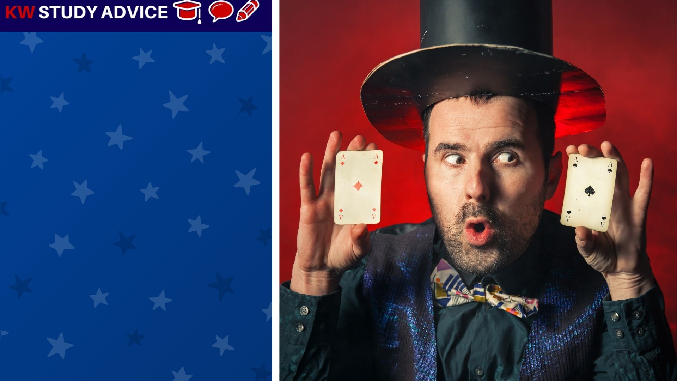
Bizarre
This is something which looks very unusual, strange or uncommon. Bizarre things are able to catch our attention.
The magician produced a bizarre magic trick. He matched the card the other person thought of. People thought it was bizarre.

Slide 4
Utilise
This is when someone is able to make good use of something. People use tools and things to help them complete tasks.
The girl utilised the maps on her phone to help her find her way to the restaurant. She would have been lost without it.

Slide 5
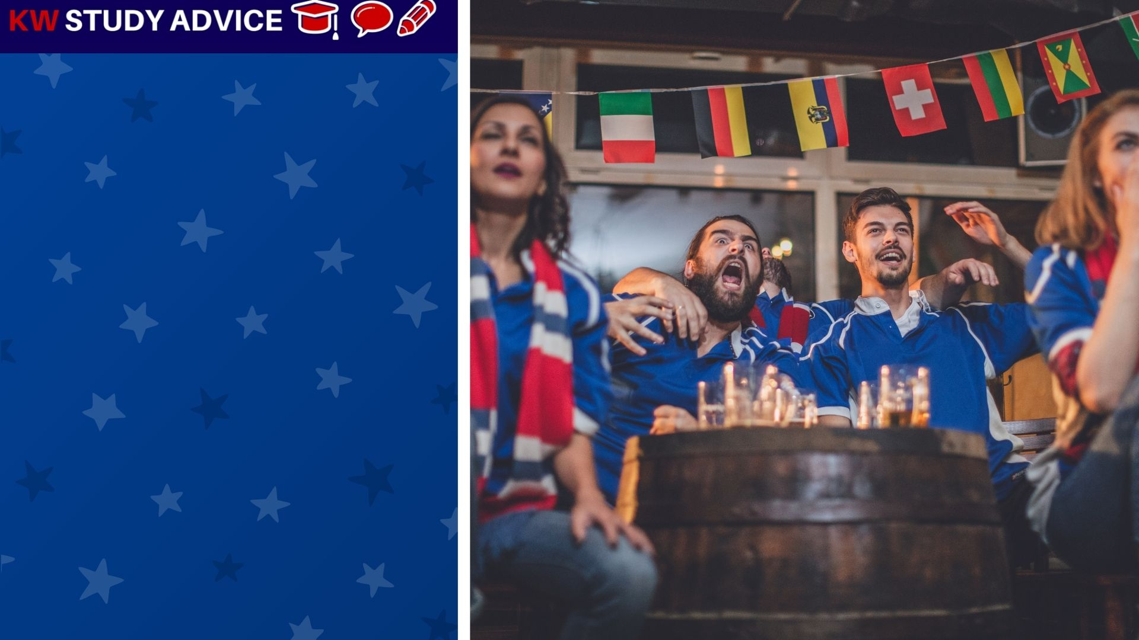
Buzz
When there is a feeling of excitement amongst a group of people. This is normally found in social situations.
There was a buzz in the bar during the football match. Many of their fans had gathered to watch the exciting match.

Slide 6
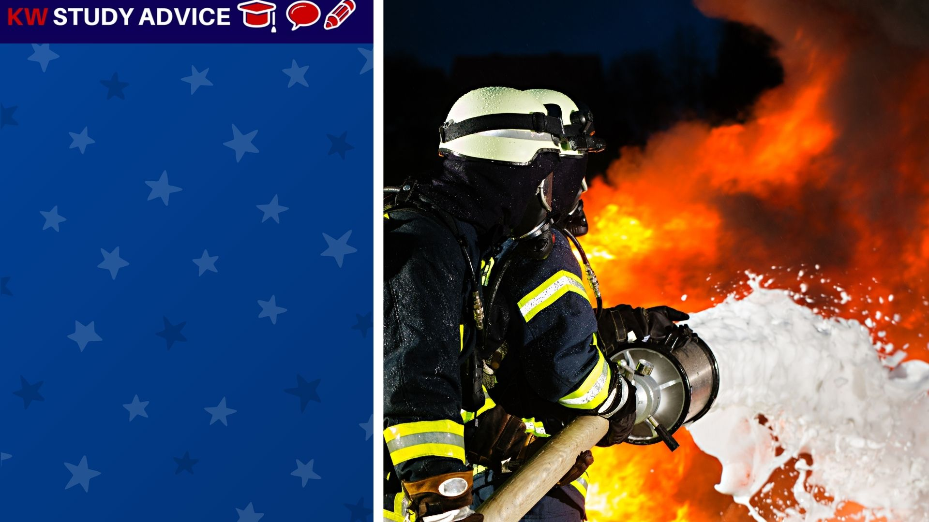
Counteract
When there is one force which fights against another in order to reduce its impact. Disasters such as fire are counteracted.
The firefighter worked extremely hard to counteract a fire which had started in the village. It was put out in less than 1 hour.

